Slide 1
Next generation authentication (NGA)
Member Experience
March 2018

Slide 2
Authentication through
payflex mobile®

Slide 3
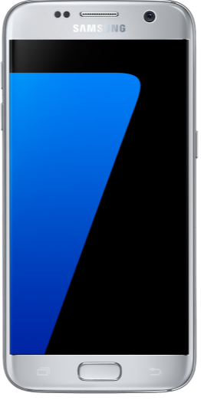
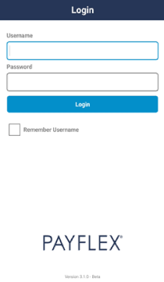
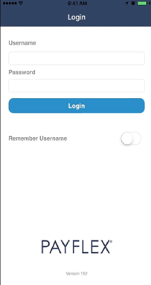
Log in
Android
Apple

Slide 4
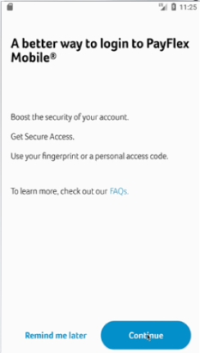
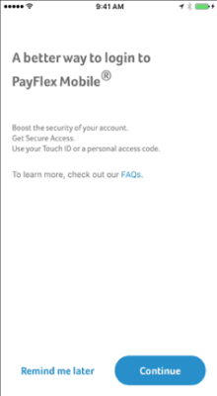
Set up secure access
Android
Apple

Slide 5
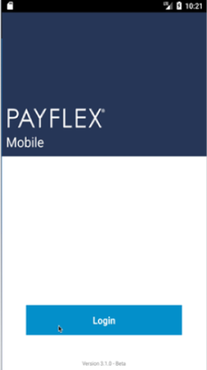
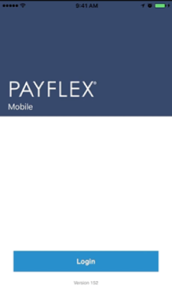
Option 1: Log in with your fingerprint
Android
Apple

Slide 6
Option 2: Log in with your 6-digit access code
Android
Apple
_ _ _ _ _ _
_ _ _ _ _ _

Slide 7
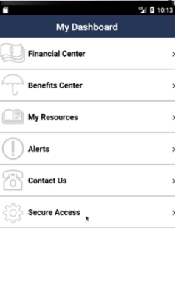
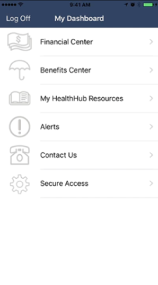
Manage your account and secure access
Android
Apple

Slide 8
thank you

